Slide 1
ARTIFICIAL INTELLIGENCE
Introduction to Artificial Agents
Presented to: Sir Usman
Presented by: Hammad Ali (4156)
Course: Artificial Intelligence
Topics Covered
Introduction to Artificial Agents
Structure of an Agent
How an Agent Should Act
Rationality and Omniscience
Types of Agent Programs

Slide 2

What is an Artificial Agent?
An artificial agent is a computer system that can observe its environment, understand the situation, make decisions, and take actions to achieve a goal.
Example: A robot vacuum cleaner perceives dirt and obstacles, decides where to move next, and acts by cleaning the floor.
An agent perceives, thinks, and acts.

Slide 3

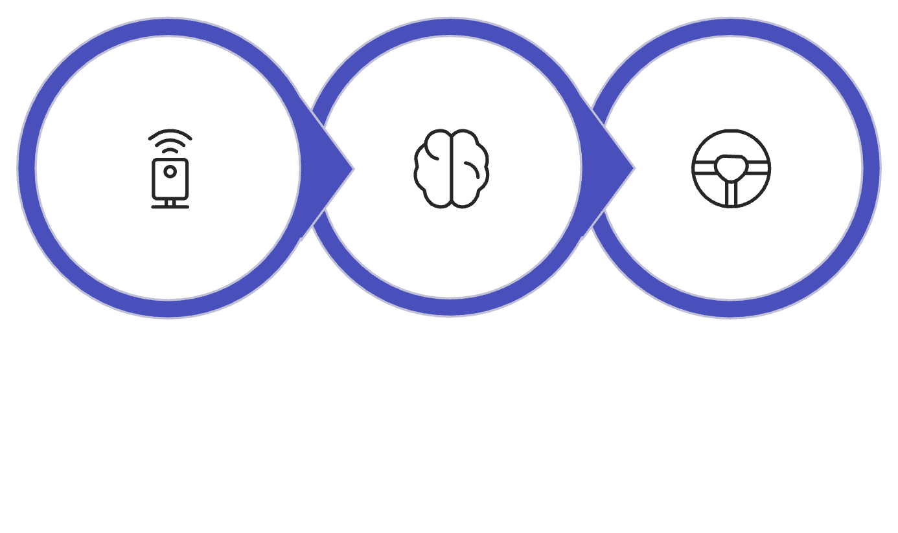
How Does an Agent Work?
An agent generally follows these steps:
Perceive
Decide
Act
For example, a self-driving car:
Perceive: Detects roads, cars, and traffic lights
Decide: Determines what action is needed
Act: Turns, stops, or moves forward
Key point: An agent continuously interacts with its environment.

Slide 4

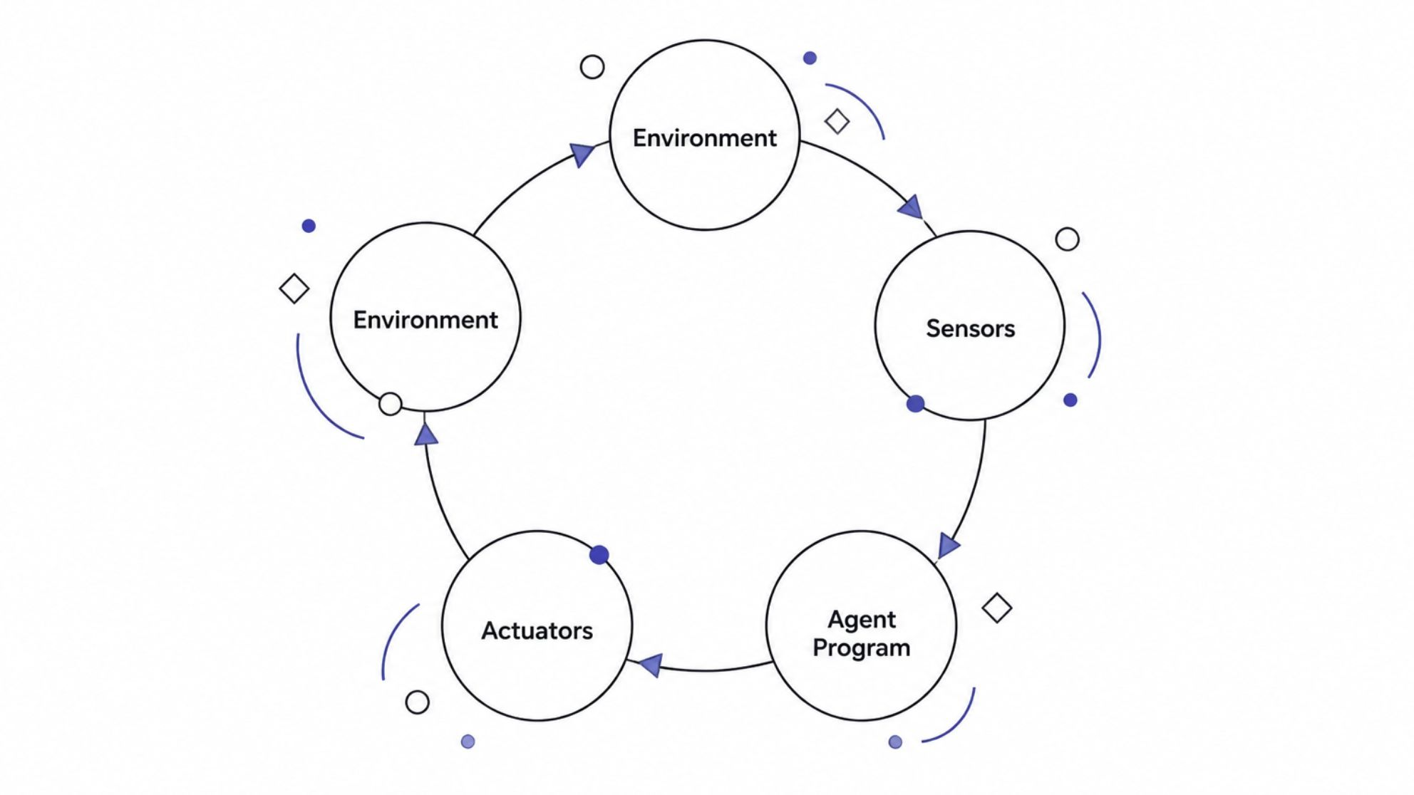
Structure of an Agent
The basic structure of an agent consists of three main components:
Sensors - Used to receive information from the environment
Agent Program - Processes information and decides what to do
Actuators - Perform the selected action
Example: Robot → Camera → AI Program → Motors → Movement

Slide 5
How Should an Agent Act?
An agent should choose an action that helps it achieve its goal.
01
02
03
Observe the environment
Understand available information
Consider possible actions
04
05
Choose the best action
Learn from results when possible
Example: A navigation app selects a route that helps you reach your destination efficiently.

Slide 6
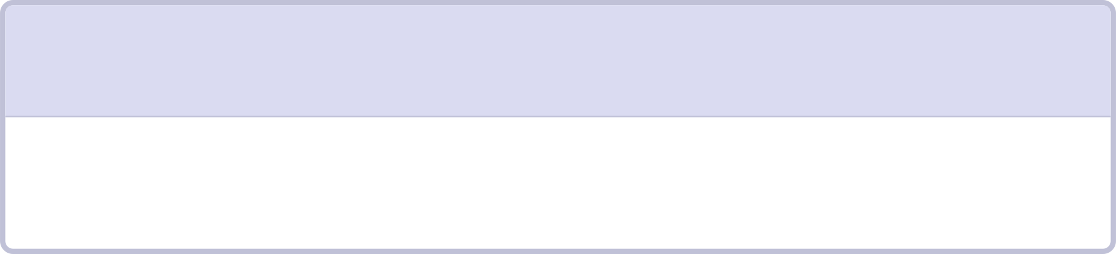

What is Rationality?
Rationality means choosing the best possible action based on the available information.
1
2
Tries to achieve its goals
Uses available information
3
4
Considers possible results
Chooses an appropriate action
Example: If it starts raining, a rational agent may suggest taking an umbrella.
Important: Rational does not always mean perfect. The agent can make mistakes because it may have limited information.

Slide 7
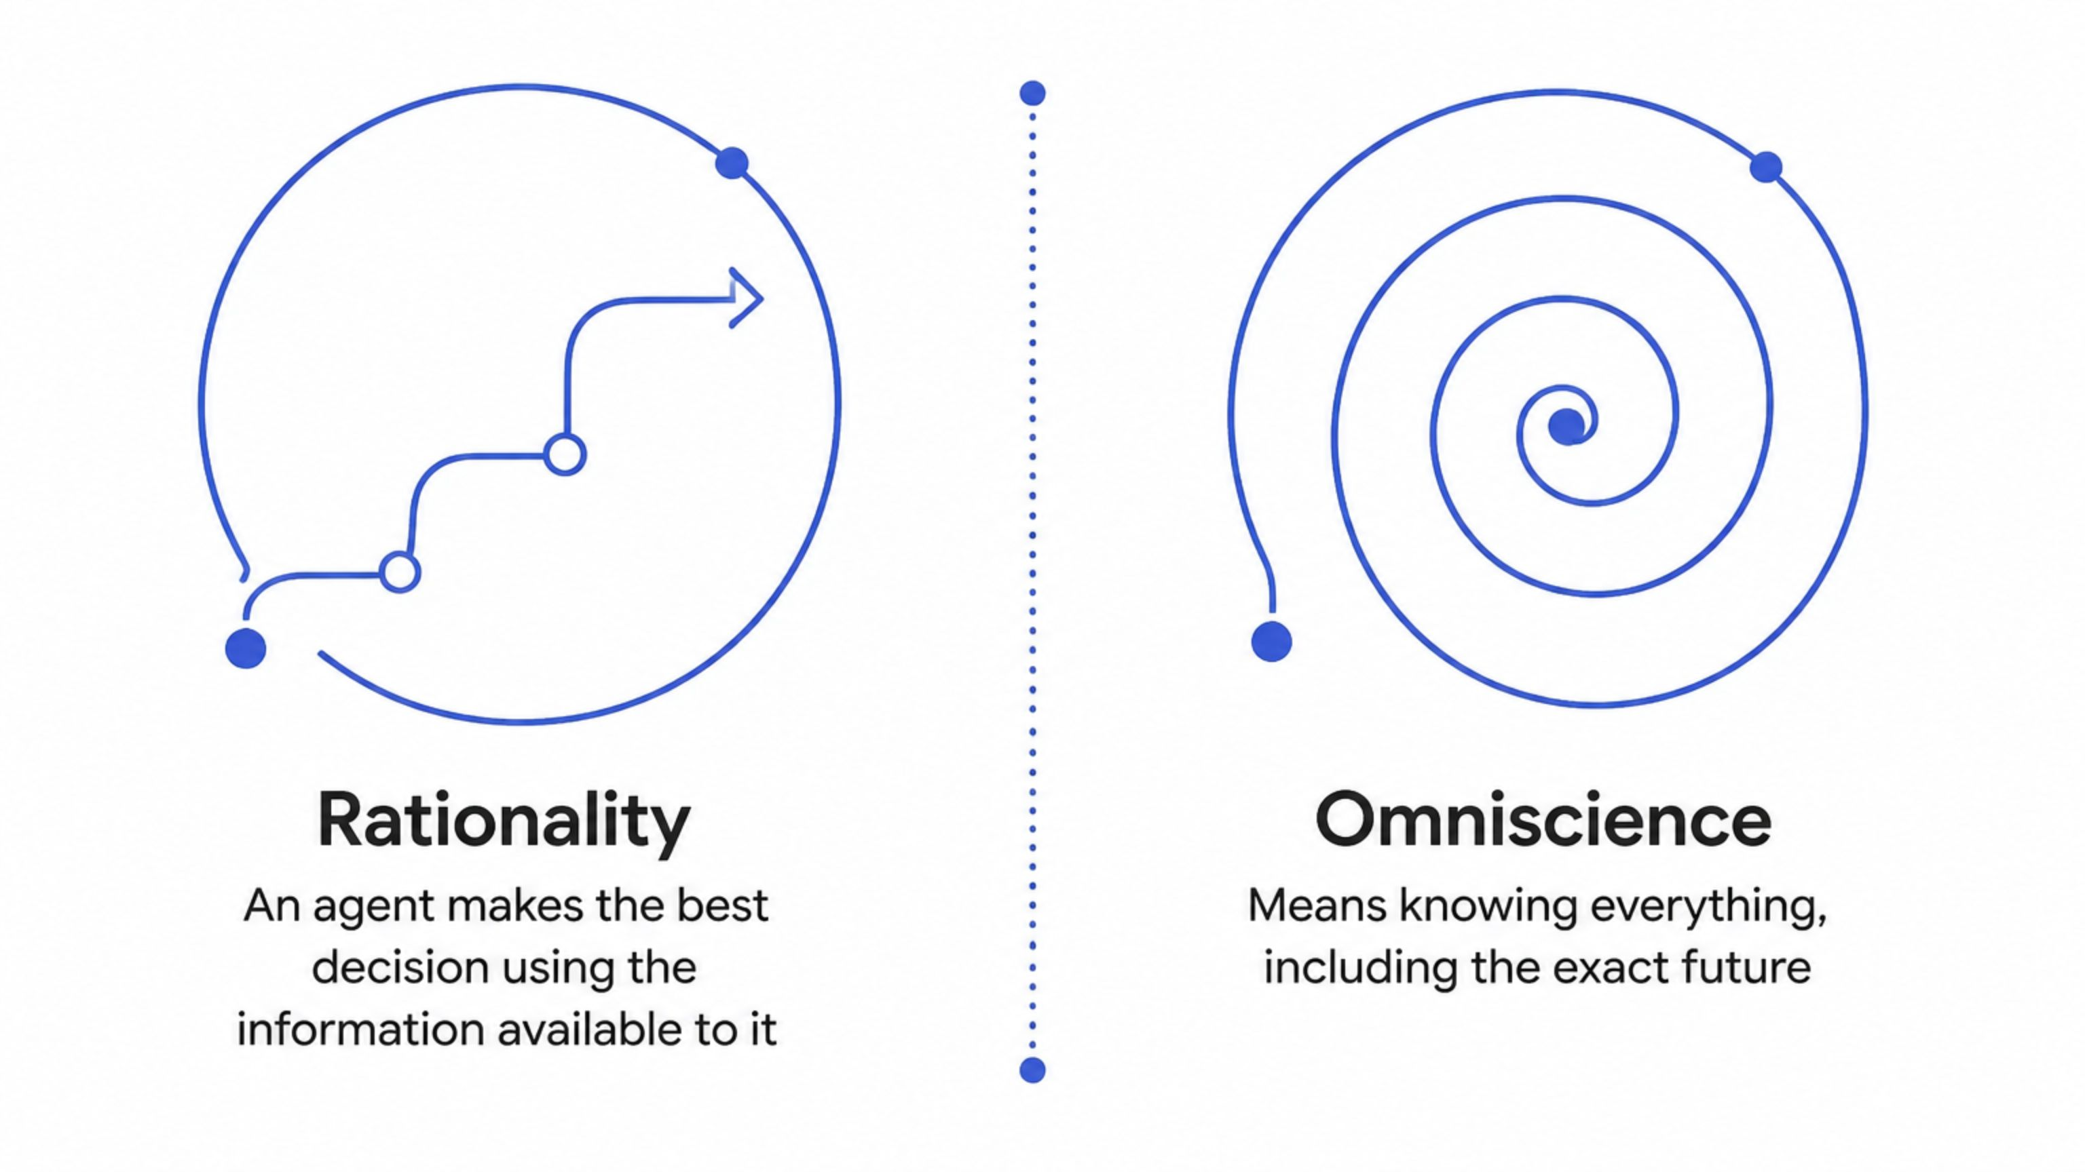
Rationality vs. Omniscience
Example: A navigation system may choose the best route using current traffic data. But it cannot know with complete certainty that an unexpected road closure will happen 10 minutes later.
Therefore: A rational agent does not need to be omniscient.

Slide 8

Types of Agent Programs
There are four main types of agent programs:
1
2
Simple Reflex Agent
Model-Based Reflex Agent
3
4
Goal-Based Agent
Utility-Based Agent
These agents differ in how they make decisions.

Slide 9
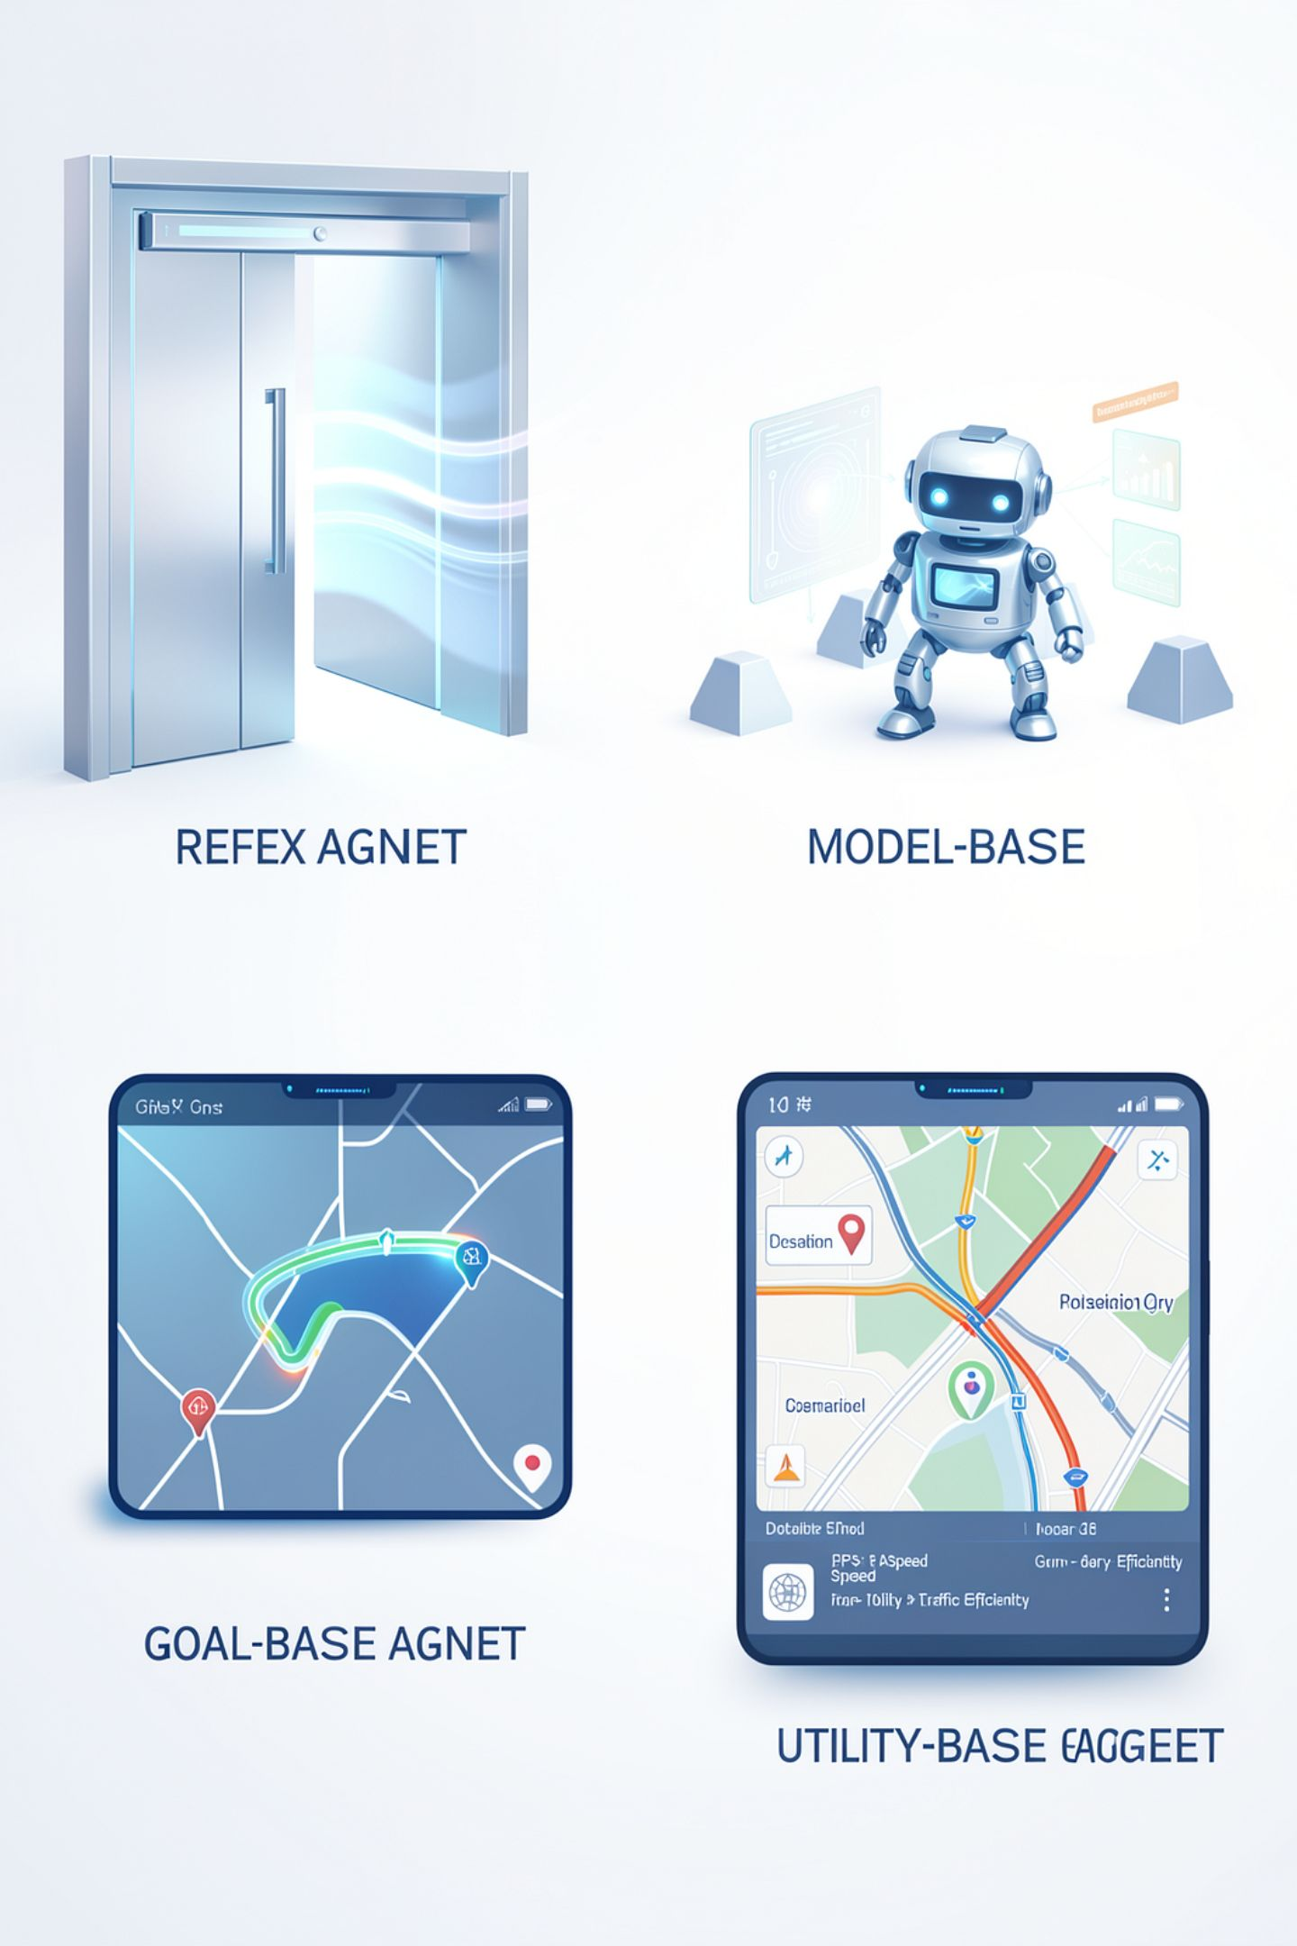
Types Explained
01
Simple Reflex Agent
Acts according to the current situation.
Example: Automatic door opens when it detects a person.
02
Model-Based Agent
Uses information about the current and previous situations.
Example: A robot remembers obstacles it has already detected.
03
Goal-Based Agent
Chooses actions to achieve a specific goal.
Example: GPS finding a route to a destination.
04
Utility-Based Agent
Chooses the action that provides the best overall result.
Example: GPS choosing a route that is fast and has less traffic.

Slide 10
Conclusion
Key Takeaways:
Artificial agents are important parts of AI
They observe their environment and take actions
Sensors collect information and actuators perform actions
A rational agent chooses the best possible action based on available information
Rationality is different from omniscience
Different agent programs are used for different situations
Thank You!

